Slide 1
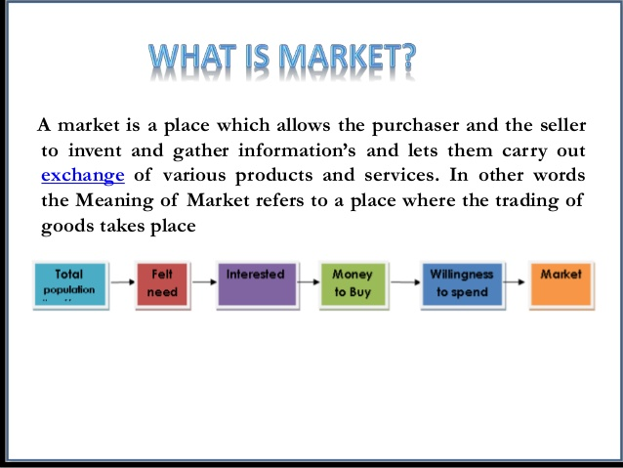

Slide 2


Slide 3
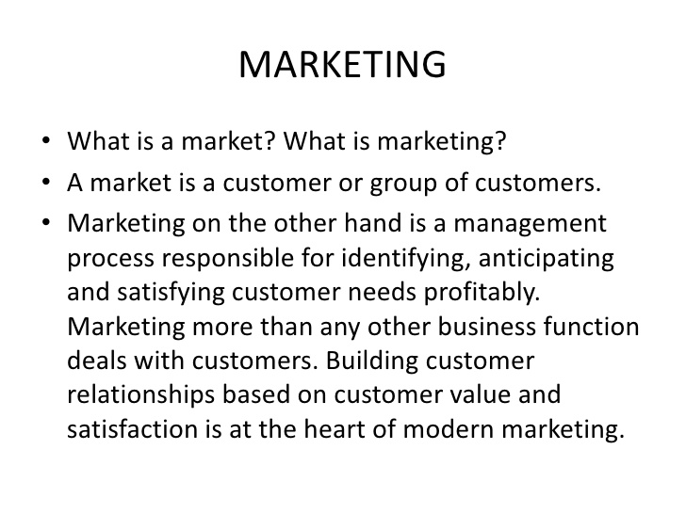

Slide 4
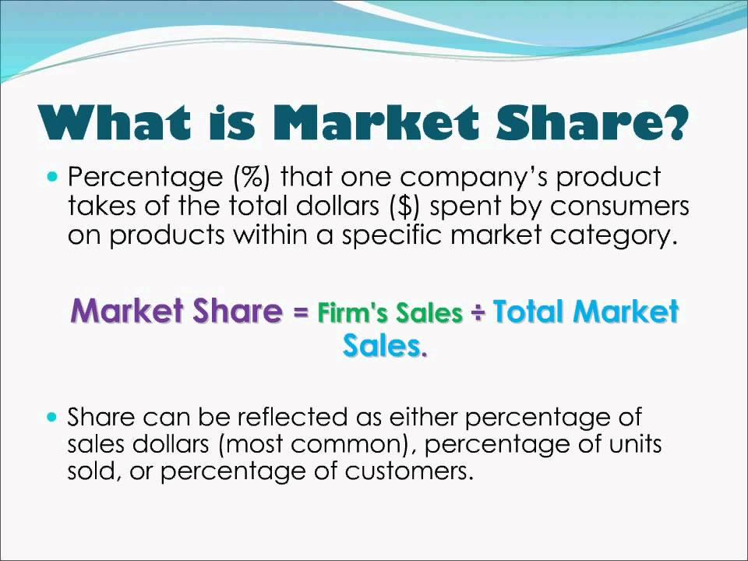

Slide 5
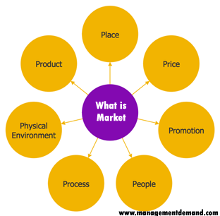

Slide 6
A market is one of the many varieties of systems, institutions, procedures, social relations and infrastructures whereby parties engage in exchange. While parties may exchange goods and services by barter, most markets rely on sellers offering their goods or services (including labor power) in exchange for money from buyers. It can be said that a market is the process by which the prices of goods and services are established.

Slide 7
Markets can differ by products (goods, services) or factors (labour and capital) sold, product differentiation, place in which exchanges are carried, buyers targeted, duration, selling process, government regulation, taxes, subsidies, minimum wages, price ceilings, legality of exchange, liquidity, intensity of speculation, size, concentration, exchange asymmetry, relative prices, volatility and geographic extension.

Slide 8
Given the centrality of customer needs, and wants in marketing, a rich understanding of these concepts is essential:[
Needs: Something necessary for people to live a healthy, stable and safe life. When needs remain unfulfilled, there is a clear adverse outcome: a dysfunction or death. Needs can be objective and physical, such as the need for food, water, and shelter; or subjective and psychological, such as the need to belong to a family or social group and the need for self-esteem.
Wants: Something that is desired, wished for or aspired to. Wants are not essential for basic survival and are often shaped by culture or peer-groups.
Demands: When needs and wants are backed by the ability to pay, they have the potential to become economic demands.

Slide 9
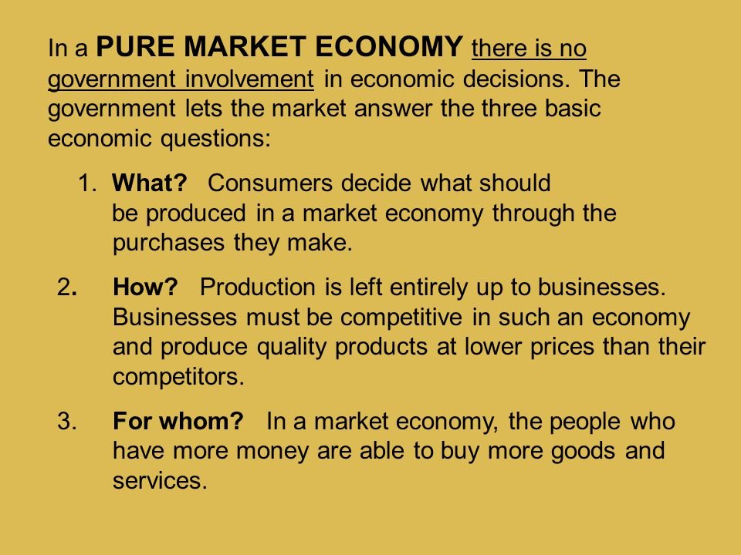

Slide 10
